Slide 1
EUROPEAN DIGITAL PORTFOLIO FOR UNIVERSITY STUDENTS
European Digital Portfolio for University Students
“The e-Portfolio for all University Students in Europe”
This project is supported by the EU. Any communication or publication related to the Project made by the beneficiaries jointly or individually in any form and using any means, shall indicate that it reflects only the author's view and that the NA and the Commission are not responsible for any use that may be made of the information it contains.

Slide 2
B7. My Portfolio
B7.1. Adding new Categories and sub-categories
Dynamic = Not fully structured
Semi Structure
There is an original and permanent folder structure
Education
Work Experience
Projects
Skills & Competencies
Foreign Languages
Conferences
Training
All content is created via an online editor
You can add the content for better searching (through the Database)
Files – Links – Videos – Images etc ….
This project is supported by the EU. Any communication or publication related to the Project made by the beneficiaries jointly or individually in any form and using any means, shall indicate that it reflects only the author's view and that the NA and the Commission are not responsible for any use that may be made of the information it contains.

Slide 3
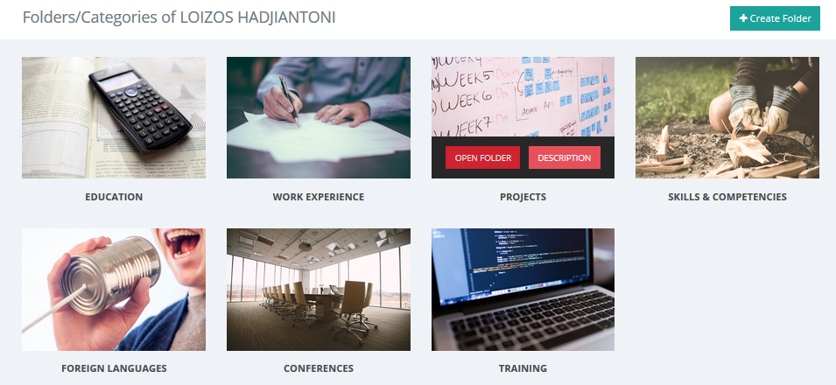
B7. My Portfolio
B7.1. Adding new Categories and sub-categories
Creating Categories/Folders
This project is supported by the EU. Any communication or publication related to the Project made by the beneficiaries jointly or individually in any form and using any means, shall indicate that it reflects only the author's view and that the NA and the Commission are not responsible for any use that may be made of the information it contains.

Slide 4
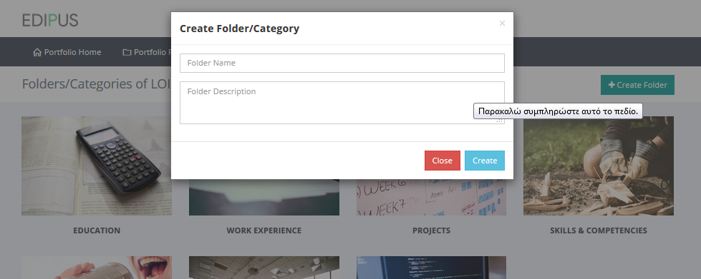
B7. My Portfolio
B7.1. Adding new Categories and sub-categories
This project is supported by the EU. Any communication or publication related to the Project made by the beneficiaries jointly or individually in any form and using any means, shall indicate that it reflects only the author's view and that the NA and the Commission are not responsible for any use that may be made of the information it contains.

Slide 5
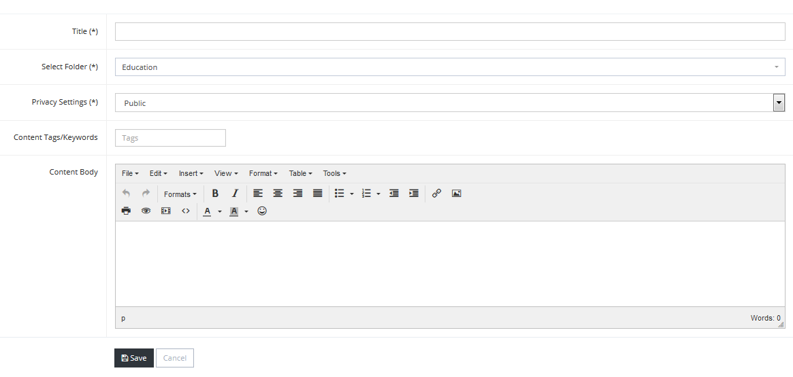
B7. My Portfolio
B7.1. Adding new Categories and sub-categories
Creating Content
This project is supported by the EU. Any communication or publication related to the Project made by the beneficiaries jointly or individually in any form and using any means, shall indicate that it reflects only the author's view and that the NA and the Commission are not responsible for any use that may be made of the information it contains.

